Slide 1

Tax Rate Process
for
Area Extension Directors
Extension Business Office
7/13/2023

Slide 2
TABLE OF CONTENTS
General Information
Step One: Certification Assessment (45-day countdown begins)
Step Two: Calculating Rates
Step Three: Information Verified & Sent to Counties
Step Four: EDB Meeting to set Tax Rates
Step Five: Tax Rate Approval Process
Step Six: Returning Documentation
Extension business office

Slide 3

Tax Rate Process Related to Cooperative Extension
Certified Tax Assessment amounts provided to EBO by the DLG.
Tax Rates are calculated & information forwarded to REDs/AEDs/RSS.
Information is compiled/verified & sent to AEDs to share with counties.
EDB conducts meeting to set Tax Rate.
Depending on the Tax Rate set, additional steps may be involved as required by statute (e.g. Notifying Fiscal Court If Rate Generates Certain Revenue Levels, etc.).
AFTER rates are set by EDB – information needs to be sent back to appropriate offices (DOR/EBO).
Counties Have 45 Days From The Certification Date
To Establish The Tax Rates
Extension business office

Slide 4
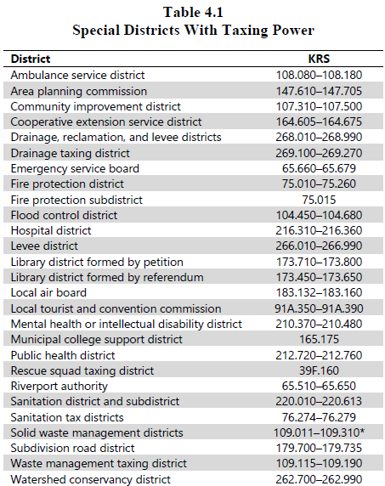
Special District Taxing Power
A county tax bill may include ad valorem tax levies for several special districts. Cooperative Extension Districts being one of these special districts.
Ad valorem tax is one based on the value of the object being taxed
The diagram lists special districts with the power to levy ad valorem taxes.
Extension business office
Notes:
County governments in Kentucky have traditionally depended on the property tax for the bulk of local tax revenue.
Ad Valorem
Latin term meaning "according to the value of something"
The term is used in taxation to designate taxes levied against property, real or personal, at a certain rate based upon the property's value.
An ad valorem tax is levied according to the value of the property as determined by an assessment or appraisal.

Slide 5
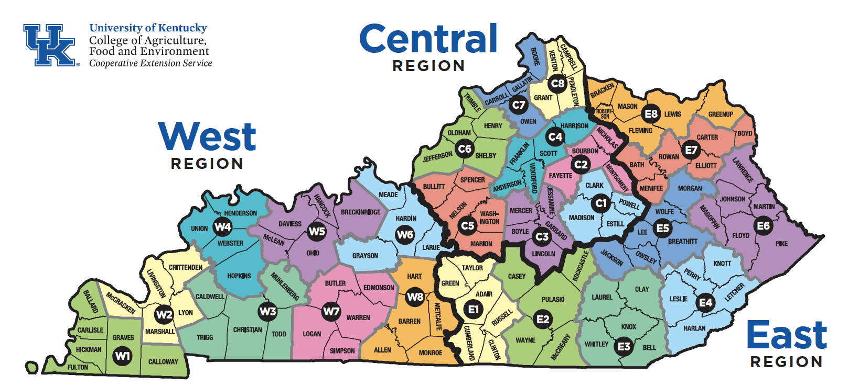
Non-Taxing Cooperative Extension Districts
Hancock County
Hart County
Jefferson County
Rowan County
Trigg County
Extension business office

Slide 6
Basic Tax Types
Real Property – Includes land, buildings, and other improvements of a personal nature.
Tangible Personal Property - Every physical item subject to ownership, except real and intangible property. Comprised of property that can be moved or touched, and commonly includes items such as business equipment and furniture.
Motor/Vehicle Watercraft - Annual tax assessed on motor vehicles and motorboats. Payment shall be made to the motor vehicle owner's County Clerk.
Extension business office

Slide 7
Optional Tax Types
Aircraft – Aircraft not used in the business of transporting persons or property for compensation. (e.g., Aircrafts owned by individuals for personal use).
Documented Watercraft – Federally documented vessels not used in the business of transporting persons or property for compensation or hire or for other commercial purposes.
In-Transit Inventory – Personal property held for shipment out of state.
Extension business office
Notes:
These are located on the Property Tax Request Form (62A3000).
Some notes from previous years: please be sure to include the current (2023) year on the top of this form. Also, it’s important that the EDB minutes also reflect the Yay/Nay of these optional taxes.

Slide 8

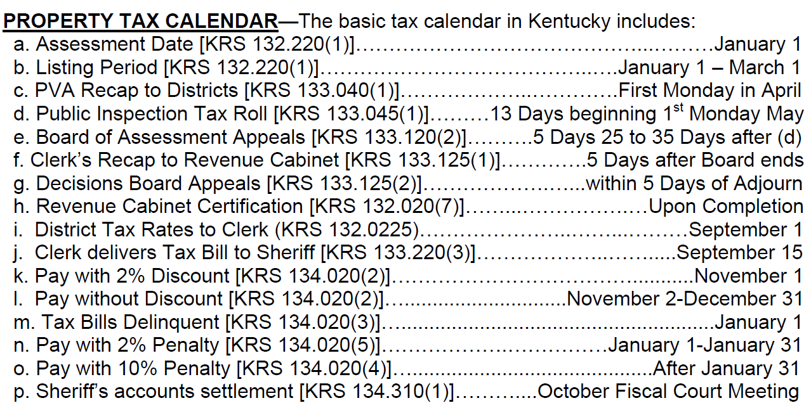
Property Tax Calendar
Extension business office
Notes:
Receipt of Certifications is what kicks off the process for Cooperative Extension
Board of Assessment Appeals – At Earliest based on calendar would be mid June. I believe the first certifications we received last year came from DLG on 7/28 (but that was impacted somewhat by COVID).
BE MINDFUL OF YOUR WINDOW OF TIME – SOMETIMES THE WINDOW AND TURNAROUND IS VERY VERY SHORT!

Slide 9
Area Extension Director Roles in the Tax Rate Process
Turnaround is CRUCIAL to this process
Take opportunity to encourage counties to secure an auditor
Extension business office

Slide 10
AED Roles In The Tax Rate Process
WILL be responsible for attending EDB tax rate meetings and presenting tax rate information.
WILL provide guidance to the EDB regarding processes and steps in setting tax rates. WILL NOT provide input on what the EDB should do in terms of what rate they should set.
WILL be responsible for filling out all tax rate documentation and submitting it to the appropriate recipients, which includes Regional Staff, County Clerk and Department of Revenue (DOR).
Extension business office

Slide 11
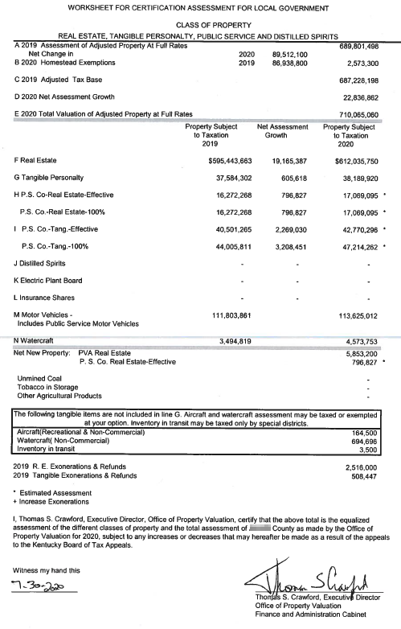
STEP ONE: Certification Assessment Received
DLG and EBO receive the Certification Assessment from the DOR
  This is a summary of the equalized assessments of the different property classes and the total assessment for a given county.
Extension business office

Slide 12
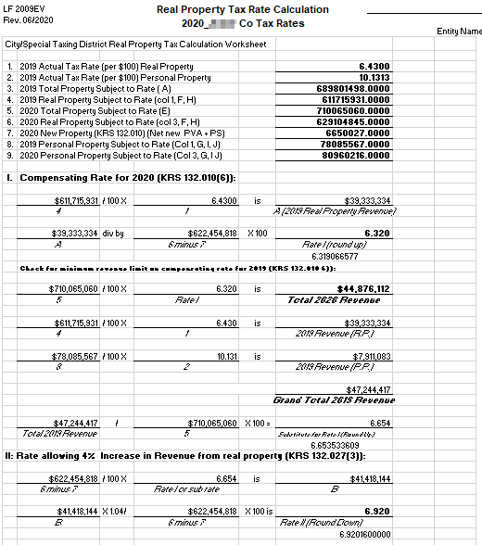
STEP TWO: Calculating Rates
DLG will use the Certification Assessment to complete the Tax Rate Calculation Worksheets which will be provided to the EBO.
The Compensating Rate and 4% Rate are both calculated since the requirements for each differ.
Due To Legislative Changes This Process Is Different Than It Has Historically Been
Extension business office

Slide 13
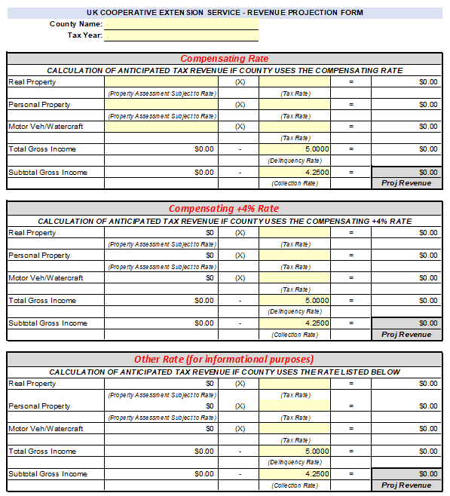
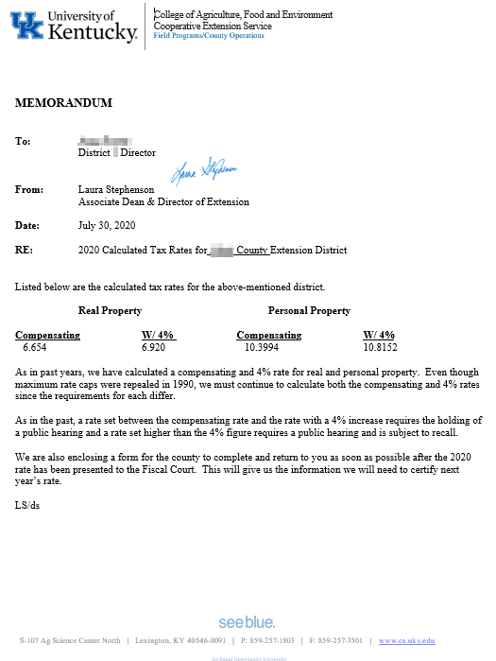
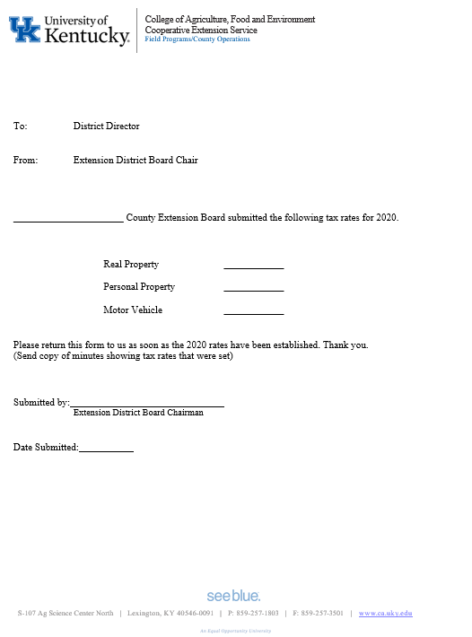
STEP TWO: Calculating Rates
Once tax rates have been received from DLG then the EBO will review and send REDs/AEDs/RSS an email which contains the following:
Property Assessment Worksheet
Tax Rate Calculations Worksheet
Tax Rate Letter
Tax Rate Return Letter
Tax Rate Revenue Projection Form
Tentative - Attachments May Be Modified Depending Upon Information Provided By DLG
Extension business office

Slide 14
STEP THREE: Information Verified & Sent to Counties
Before being shared with county, the EBO requests that REDs/AEDs/RSS review the calculation amounts and complete the Tax Rate Revenue Projection Form:
VERIFY Real Property Tax Rate Calculation Worksheet (Compare To Certification Assessment)
VERIFY Personal Property Tax Rate Calculation Worksheet (Compare To Certification Assessment)
COMPLETE Tax Rate Revenue Projection Form (Provides revenue estimates for the calculated rates)
These items should be reviewed and completed by RSS and checked by the AED
Extension business office

Slide 15
STEP THREE: Information Verified & Sent to Counties
In summary…the following items need sent from RSS to AEDs in an email using language that will be provided by the EBO:
Property Assessment Worksheet
Tax Rate Calculations Worksheet
Tax Rate Letter
Tax Rate Return Letter
Tax Rate Revenue Projection Form
Tentative - Attachments May Be Modified Depending Upon Information Provided By DLG
Extension business office

Slide 16
STEP FOUR: EDB Meeting to Set the Rates
Extension District Board Typically Have The Following Options When It Comes To Levying Tax Rates:
Levying the Compensating Rate
Levying a rate Above Compensating (but not greater than 4%)
Levying a rate Greater than 4%
Levying A New Tax *
*Applicable to EDBs who currently do NOT levy a tax or wish to begin
levying on an optional tax
Extension business office

Slide 17

STEP FOUR: EDB Meeting to Set the Rates
The direction the EDB takes in levying a tax rate determines the proper procedure.
Extension business office

Slide 18
STEP FOUR: EDB Meeting to Set the Rates
COMPENSATING RATE
The compensating tax rate is defined as that rate, when applied to the current year's assessment of real property, excluding new property, will produce an amount of revenue approximately equal as that produced last year from real property.
Therefore, as real property assessments rise, the tax rate is rolled back to keep the revenue generated from the existing real property assessments about the same.
This tax rate can be adopted automatically by the taxing district.
Extension business office

Slide 19
STEP FOUR: EDB Meeting to Set the Rates
RATE ABOVE COMPENSATING (No Greater Than 4% Increase)
Defined as a tax rate which will provide no more revenue from real property, exclusive of revenue from new property, than 4% over the amount of revenue produced by the compensating tax rate.
In other words, this rate will produce revenue from the current year's assessment, less the new property assessment, that is 4% greater than the preceding year's revenue.
This tax rate requires a public hearing before it can be put into effect.
Extension business office

Slide 20
STEP FOUR: EDB Meeting to Set the Rates
PUBLIC HEARING (per KRS 132.023)
A special purpose governmental entity (SPGE) proposing to levy a tax rate which exceeds the compensating tax rate shall submit the proposed rate as required by KRS 65A.110 and shall hold a public hearing to hear comments from the public regarding the proposed tax rate.
The hearing shall be held in the same location where the governing body of the city or county where the largest number of citizens served by the SPGE reside meets and shall be held immediately before a regularly scheduled meeting of that governing body.
Extension business office

Slide 21
STEP FOUR: EDB Meeting to Set the Rates
PUBLIC HEARING (per KRS 132.023)
The SPGE shall advertise the hearing for two (2) consecutive weeks, in the newspaper of largest circulation in the county, a display type advertisement of not less than twelve (12) column inches.
In lieu of the two (2) published notices, a single notice containing the required information may be sent by first-class mail to each person owning real property.
The hearing shall be open to the public. All persons desiring to be heard shall be given an opportunity to present oral testimony.
Extension business office

Slide 22
STEP FOUR: EDB Meeting to Set the Rates
RATE GREATER THAN 4%
A taxing district may levy a rate that will produce more than 4% additional revenue from real property taxed the preceding year.
Before this rate can be set, a public hearing must be held AND the voters can petition that the increase above 4% be put to a recall vote.
Extension business office

Slide 23
STEP FOUR: EDB Meeting to Set the Rates
PUBLIC HEARING AND SUBJECT TO RECALL (per KRS 132.023)
That portion of a tax rate levied by an action of a SPGE which will produce revenue from real property, exclusive of revenue from new property, more than four percent (4%) over the amount of revenue produced by the compensating tax rate shall be subject to a recall vote or reconsideration by the SPGE as provided for in KRS 132.017.
Extension business office

Slide 24
STEP FIVE: Tax Rate Approval Process – Proper Notification
Compensating Rate
If adopted by the EDB . . .
Present a copy of the Tax Rates to the Fiscal Court.
Complete required documentation & return to appropriate recipient(s).
Extension business office

Slide 25
STEP FIVE: Tax Rate Approval Process – Proper Notification
Above Compensating Rate
If proposed by the EDB…
Make sure proper procedure for Public Hearings/Recall is followed.
Within seven (7 Days) after the Motion to Levy A Tax, notify IN WRITING the proposed rate to the fiscal court. (Per Senate Bill 5/KRS 65A.110 – Details On Following Slides)
Fiscal Court will have 30 days from the date of submission to Approve/Disapprove/Fail To Act on the rate.
Complete required documentation & return to appropriate recipient(s).
Extension business office

Slide 26
STEP FIVE: Tax Rate Approval Process – Proper Notification
Above Compensating Rate
Fee and Tax Rate Approval from local governments changes stemming from SB5 and KRS 65A.110
On and after January 1, 2021, local governments have an opportunity to approve or disapprove of SPGE property tax rates and fees.
Extension business office

Slide 27
STEP FIVE: Tax Rate Approval Process – Proper Notification
Above Compensating Rate
When an SPGE intends to raise a property tax rate above the compensating tax rate or a tax rate that is being set for the very first time, the SPGE notifies its local government of jurisdiction of that fact. Per KRS 65.100, a local government has 30 days to:
Approve the rate as submitted or fail to act on the rate (in which the rate is then deemed approved by action of law),
Approve a lesser rate, or
Disapprove the rate in its entirety.
Extension business office

Slide 28
STEP FIVE: Tax Rate Approval Process – Proper Notification
Property Tax Calendar
RATE REQUIRED WITHIN 45 DAYS OF CERTIFICATION
A district setting a tax rate that is not subject to recall vote shall establish a final tax rate within forty-five (45) days of Department of Revenue Certification of Assessment (KRS 132.017).
Any district failing to meet the deadline shall be required to use the compensating tax rate for that year’s property tax bills (KRS 132. 0225).
Extension business office

Slide 29
STEP SIX: Returning Documentation
Completing Forms – Tax Rate Established
Property Tax Rate Request Form (62A3000) – County should have received this form typically in July from DOR. Completed form should be returned to: DOR (mailed, faxed or emailed) & County Clerk and RSS. Please mark 2023 at the top of this form.
  https://revenue.ky.gov/Forms/62A3000_v0423.pdf
Motor Vehicle Tax Rate Return Form – County should have received this form typically in July from DOR. Completed form should be returned to DOR and RSS. https://cafebusinesscenter.ca.uky.edu/files/motor_vehicle_tax_rate_return_letter_instructions.pdf
2023 Tax Rate Return Letter (EBO) – This form was sent by the EBO and should have been received by the county with their initial tax rate information. Completed form should be returned to RSS.
EDB Minutes Showing Rates – Make sure minutes reflect the actual rates selected. Copy of minutes should be provided to the RSS.
Extension business office

Slide 30
STEP SIX: Returning Documentation
Completing Forms – Tax Rate Established
After rates are set by the EDB the following documentation should be sent to RSS (in addition to other required recipients):
Property Tax Rate Request Form (62A3000)
Motor Vehicle Tax Rate Return Form
2023 Tax Rate Return Letter
EDB Minutes Verifying Rates
After rates are set and information is received back from the county Regional Support Staff will need to scan these documents as ONE SINGLE FILE and email to: EBO@uky.edu
Extension business office

Slide 31
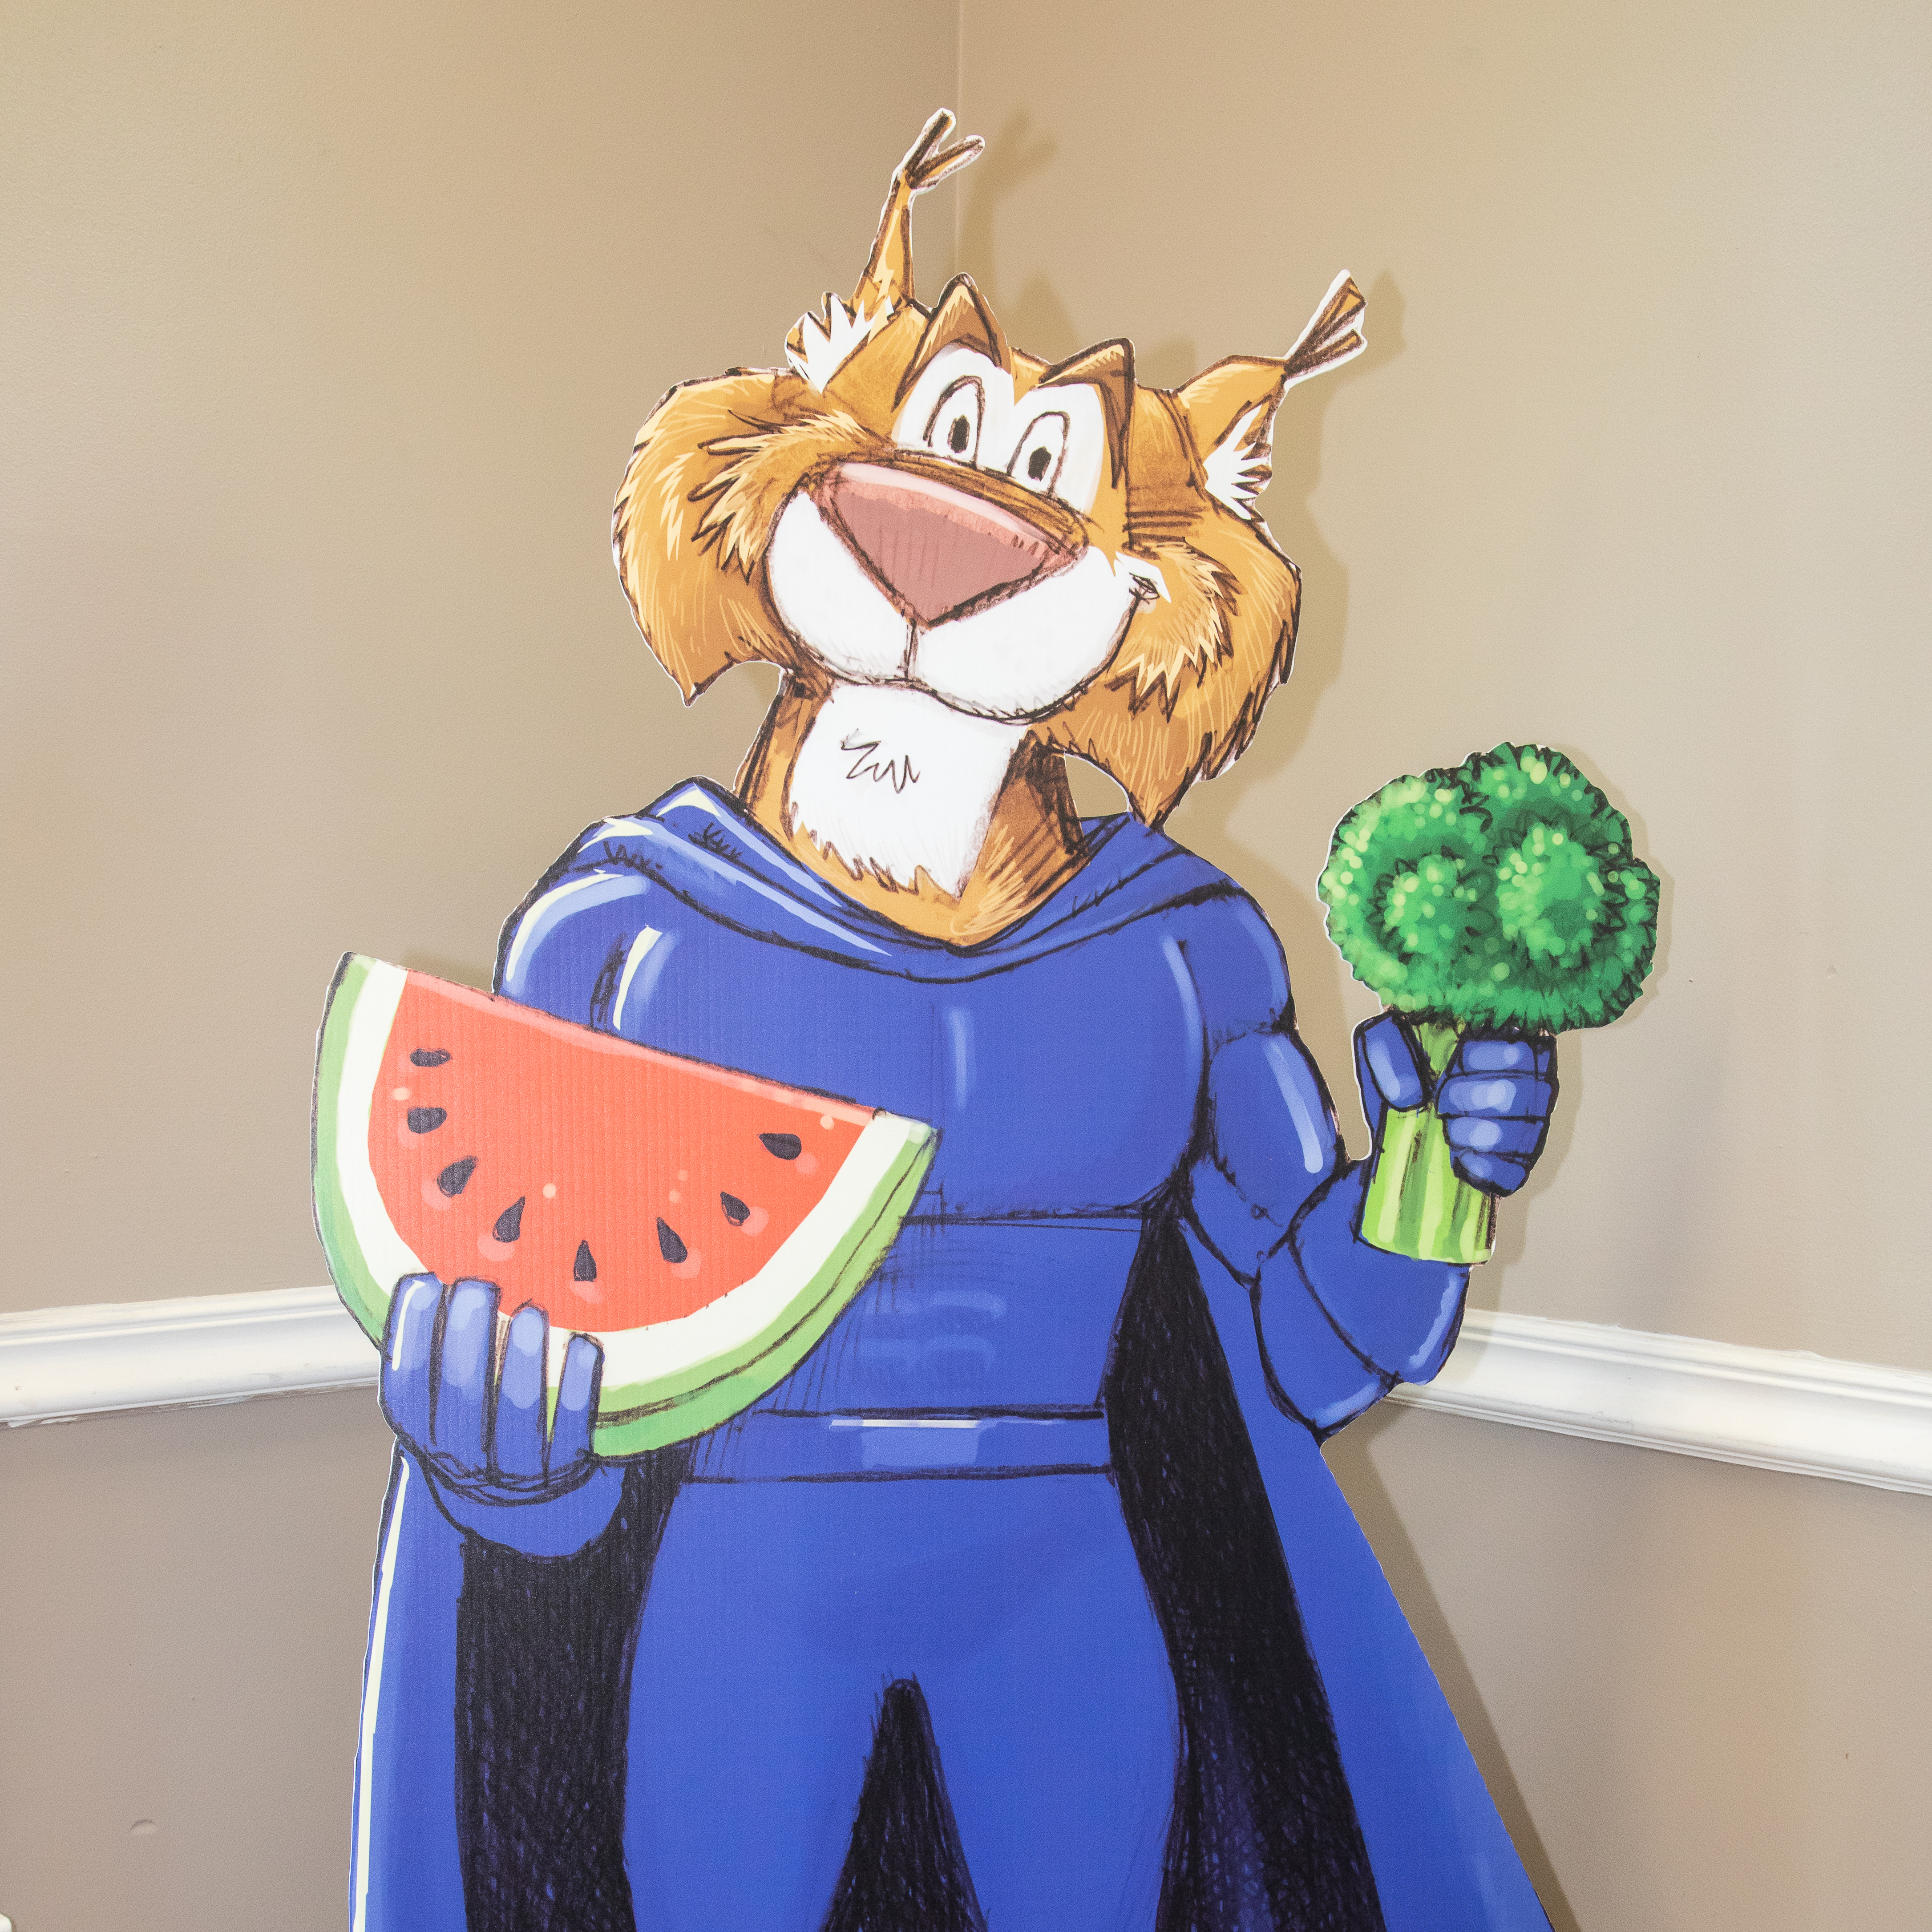

Questions
Extension business office

Slide 32


